Slide 1


Fuzzy Pooling in CNN
Fuzzy Systems and Applications
Aryan Lath
21015007

Slide 2
CONTENTS
INTRODUCTION
WHY FUZZY POOLING?
METHODOLOGY
MODEL ARCHITECTURE
RESULTS
CONCLUSION
ACKNOWLEDGEMENT

Slide 3
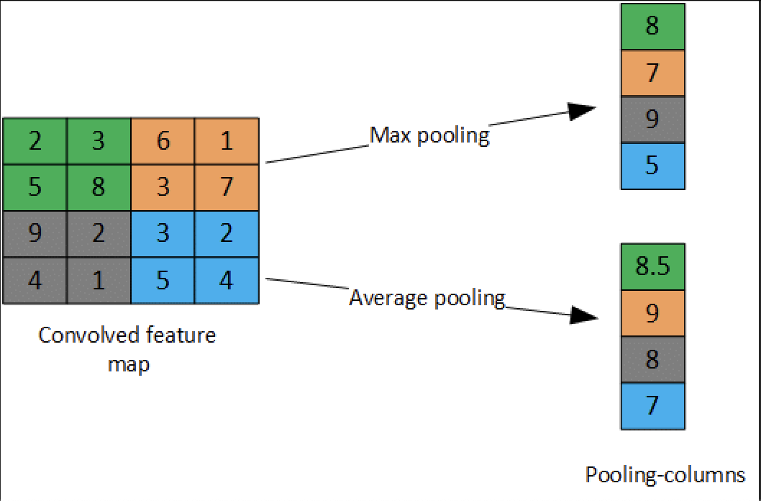
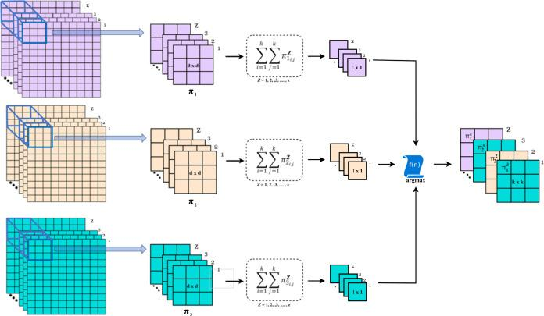
INTRODUCTION
What is Pooling?
Pooling is a downsampling technique used in convolutional neural networks (CNNs) to reduce the spatial dimensions of feature maps, thereby decreasing the number of parameters and computation in the network. It helps retain essential features while controlling overfitting, making CNN more efficient and effective for tasks like image classification and object detection.
Traditional Pooling
Fuzzy Pooling

Slide 4
WHY FUZZY POOLING?
Both max pooling and average pooling focus on a single statistical operation (either max or average) that reduces the feature map to a single, simplified representation.
Fuzzy pooling considers the distribution of values within the pooling window by categorizing values across multiple fuzzy sets. By aggregating these fuzzy membership values and then selecting the dominant fuzzy set, fuzzy pooling is able to capture more detailed and diverse patterns within the window.
After fuzzy aggregation and the selection of the dominant fuzzy set, fuzzy pooling applies defuzzification to produce a single, interpretable pooled value. This defuzzification process (such as using the Center of Gravity) creates a pooled value that is more representative of the entire pooling window, providing a more interpretable and meaningful summary.

Slide 5
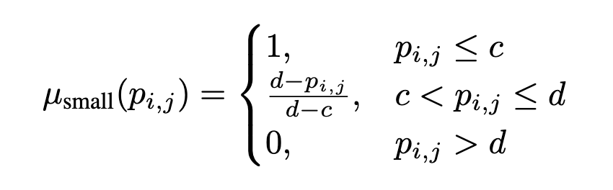
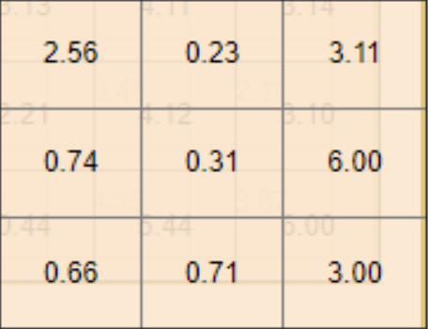
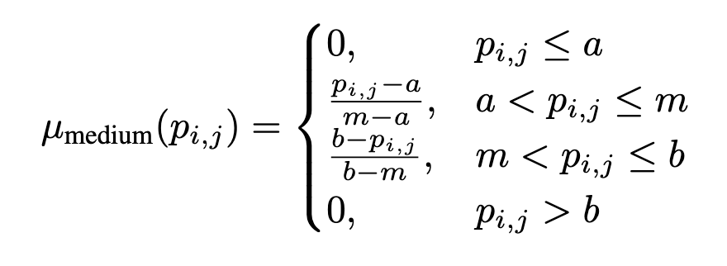
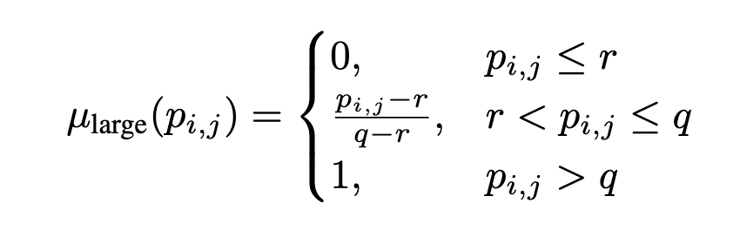
METHODOLOGY
Fuzzification
Each value in the pooling window is assigned a degree of membership in categories like 'small', 'medium', and 'large'.

Slide 6
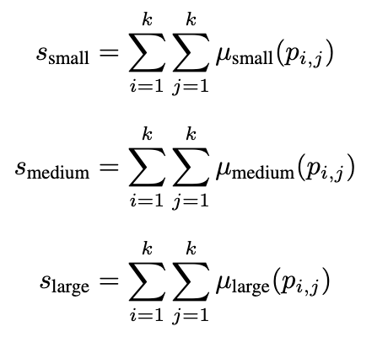
METHODOLOGY
Aggregation and Selection of the Dominant Set
The membership values for each category in the pooling window are summed to get the overall score for 'small', 'medium', and 'large'.
The category with the highest
score is chosen as the dominant fuzzy set, representing the most significant characteristic of the values within the pooling window

Slide 7
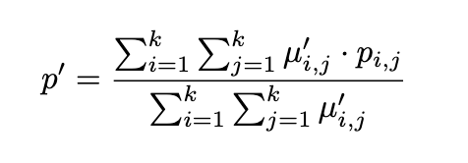
METHODOLOGY
Defuzzification
Once the dominant fuzzy set is identified, the defuzzification process is used to obtain a single representative value for the pooling window.
A common defuzzification method is the Center of Gravity(CoG) approach, which calculates a weighted average of the values in the pooling window based on their membership values in the selected fuzzy set.

Slide 8
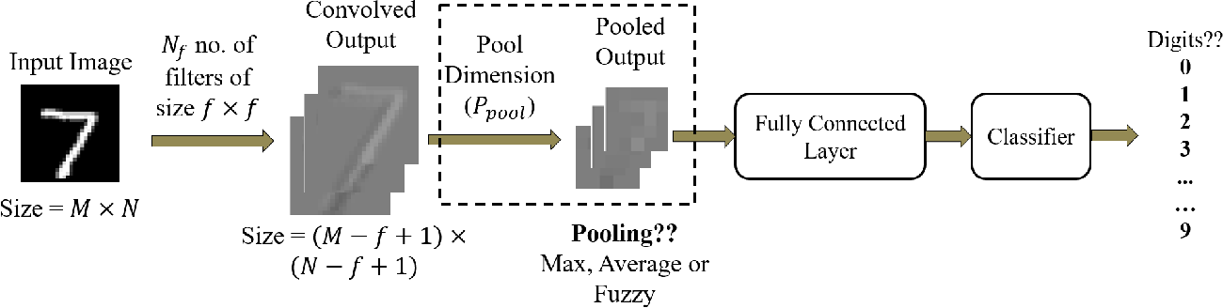
MODEL ARCHITECTURE

Slide 9
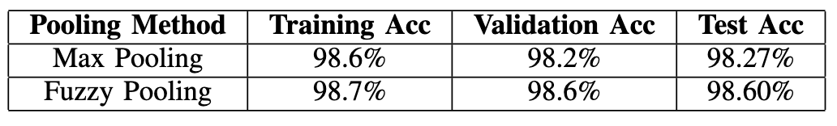
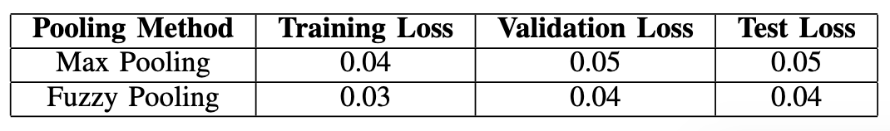
RESULTS
Accuracy Comparison of Fuzzy and Max Pooling
Loss Comparison of Fuzzy and Max Pooling
As shown, the fuzzy pooling model achieves a slightly higher accuracy across all metrics, indicating improved feature retention and robustness in the fuzzy pooling model.

Slide 10
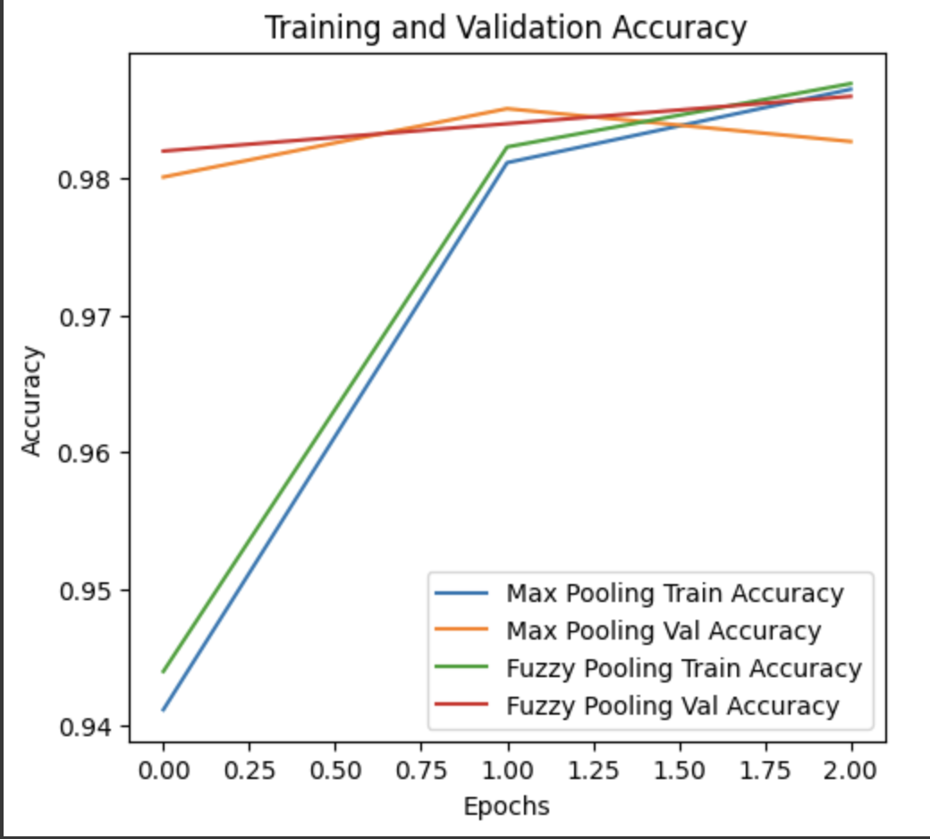
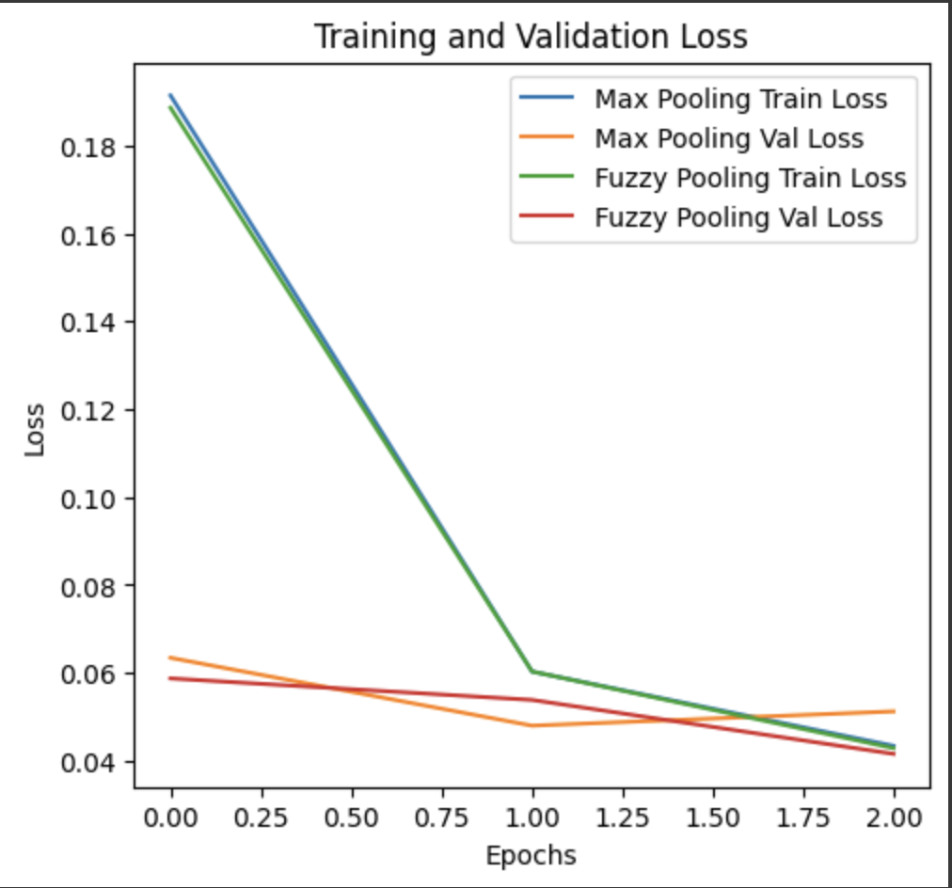
RESULTS
The improved performance of fuzzy pooling can be attributed to its ability to capture a broader range of feature values by incorporating fuzzy logic principles. This enables the model to retain more relevant information from the input feature maps, leading to more accurate predictions.

Slide 11
CONCLUSION
Unlike max pooling, which only retains the highest value in each pooling window, fuzzy pooling uses fuzzy logic to retain more information about the overall distribution of values.
Fuzzy pooling’s use of fuzzy sets makes it more robust to noise in the input data. Since values are not solely dependent on the maximum intensity in the pooling window, the network can ignore outliers or noisy pixels, resulting in a cleaner feature representation.
In image classification tasks, fuzzy pooling can improve the CNN’s ability to differentiate between classes by preserving more meaningful patterns within feature maps.
Future work may explore the combination of fuzzy pooling with other advanced CNN techniques, as well as its potential applications in diverse fields such as medical imaging, object detection, and remote sensing.

Slide 12
ACKNOWLEDGEMENT
We would like to acknowledge the foundational research that has greatly informed and inspired this study on fuzzy pooling in convolutional neural networks:
Dimitrios E. Diamantis and Dimitris K. Iakovidis, for their pioneering work on integrating fuzzy logic with pooling operations in CNNs for medical image analysis, published in IEEE Transactions on Medical Imaging.
Teena Sharma, Vikas Singh, Siddharth Sudhakaran, and Nishchal K. Verma, for their valuable contributions in advancing fuzzy-based pooling in CNNs for image classification tasks, presented at the International Conference on Artificial Intelligence and Signal Processing (AISP).
Their research provided critical insights into the application and advantages of fuzzy pooling, guiding the methodology and comparative analysis in this presentation.

Slide 13
THANK YOU
Presented By
Aryan Lath 210150007

